Slide 1



Bikes Report
View in Power BI
Last data refresh:
2/19/2026 5:48:59 PM UTC
Downloaded at:
2/20/2026 10:43:09 AM UTC

Slide 2
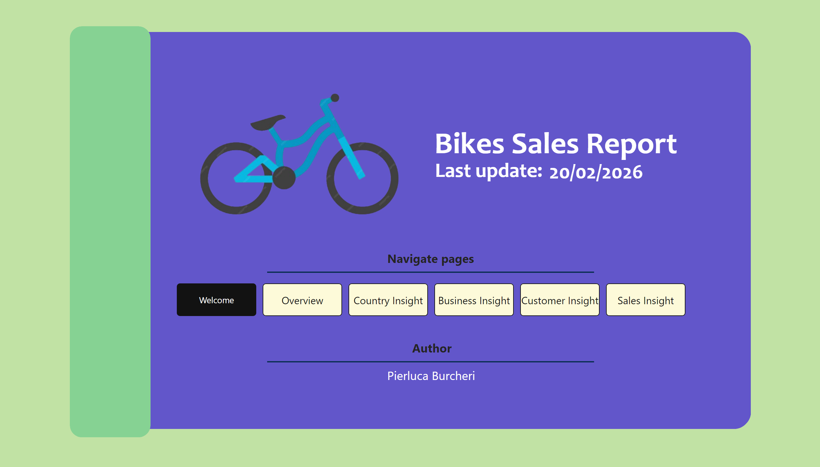
Welcome
Notes:
card
No alt text provided
textbox
No alt text provided
textbox
No alt text provided
image
No alt text provided
pageNavigator
No alt text provided
shape
No alt text provided
textbox
No alt text provided
textbox
No alt text provided
shape
No alt text provided
shape
No alt text provided
textbox
No alt text provided
shape
No alt text provided

Slide 3
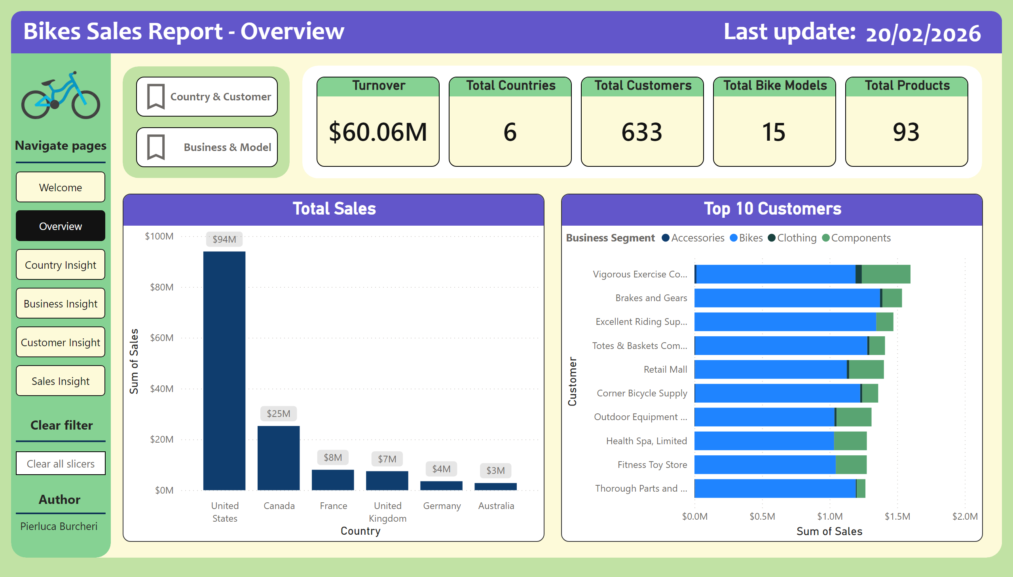
Overview
Notes:
Total Sales
No alt text provided
textbox
No alt text provided
pageNavigator
No alt text provided
shape
No alt text provided
shape
No alt text provided
shape
No alt text provided
image
No alt text provided
textbox
No alt text provided
shape
No alt text provided
Turnover
No alt text provided
Total Countries
No alt text provided
Total Customers
No alt text provided
Total Bike Models
No alt text provided
shape
No alt text provided
Total Products
No alt text provided
Top 10 Customers
No alt text provided
textbox
No alt text provided
card
No alt text provided
actionButton
No alt text provided
textbox
No alt text provided
shape
No alt text provided
shape
No alt text provided
textbox
No alt text provided
textbox
No alt text provided
clusteredColumnChart
No alt text provided
barChart
No alt text provided
shape
No alt text provided
actionButton
No alt text provided
actionButton
No alt text provided

Slide 4
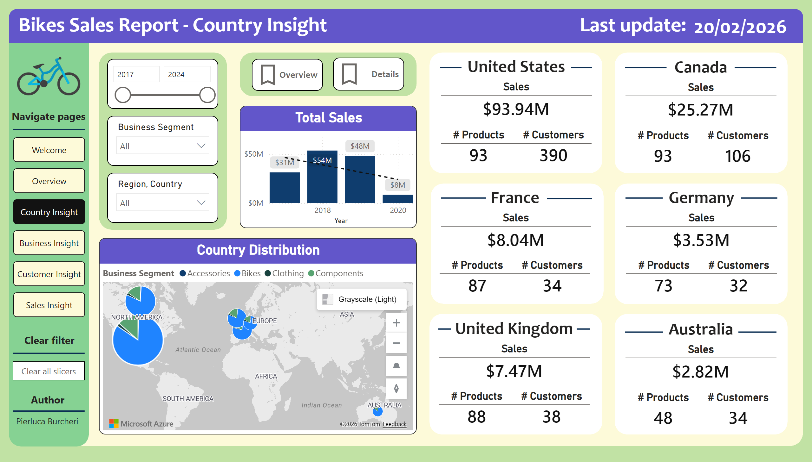
Country Insight
Notes:
textbox
No alt text provided
shape
No alt text provided
shape
No alt text provided
textbox
No alt text provided
card
No alt text provided
Country Distribution
No alt text provided
Total Sales
No alt text provided
Sales
No alt text provided
shape
No alt text provided
shape
No alt text provided
textbox
No alt text provided
# Products
No alt text provided
# Customers
No alt text provided
shape
No alt text provided
image
No alt text provided
actionButton
No alt text provided
textbox
No alt text provided
shape
No alt text provided
pageNavigator
No alt text provided
shape
No alt text provided
textbox
No alt text provided
shape
No alt text provided
shape
No alt text provided
shape
No alt text provided
textbox
No alt text provided
textbox
No alt text provided
shape
No alt text provided
shape
No alt text provided
shape
No alt text provided
shape
No alt text provided
shape
No alt text provided
Sales
No alt text provided
shape
No alt text provided
textbox
No alt text provided
# Products
No alt text provided
# Customers
No alt text provided
Sales
No alt text provided
shape
No alt text provided
textbox
No alt text provided
# Products
No alt text provided
# Customers
No alt text provided
Sales
No alt text provided
shape
No alt text provided
shape
No alt text provided
textbox
No alt text provided
# Products
No alt text provided
# Customers
No alt text provided
Sales
No alt text provided
shape
No alt text provided
shape
No alt text provided
textbox
No alt text provided
# Products
No alt text provided
# Customers
No alt text provided
Sales
No alt text provided
shape
No alt text provided
textbox
No alt text provided
# Products
No alt text provided
# Customers
No alt text provided
shape
No alt text provided
shape
No alt text provided
shape
No alt text provided
tableEx
No alt text provided
tableEx
No alt text provided
shape
No alt text provided
actionButton
No alt text provided
actionButton
No alt text provided
slicer
No alt text provided
slicer
No alt text provided
slicer
No alt text provided

Slide 5
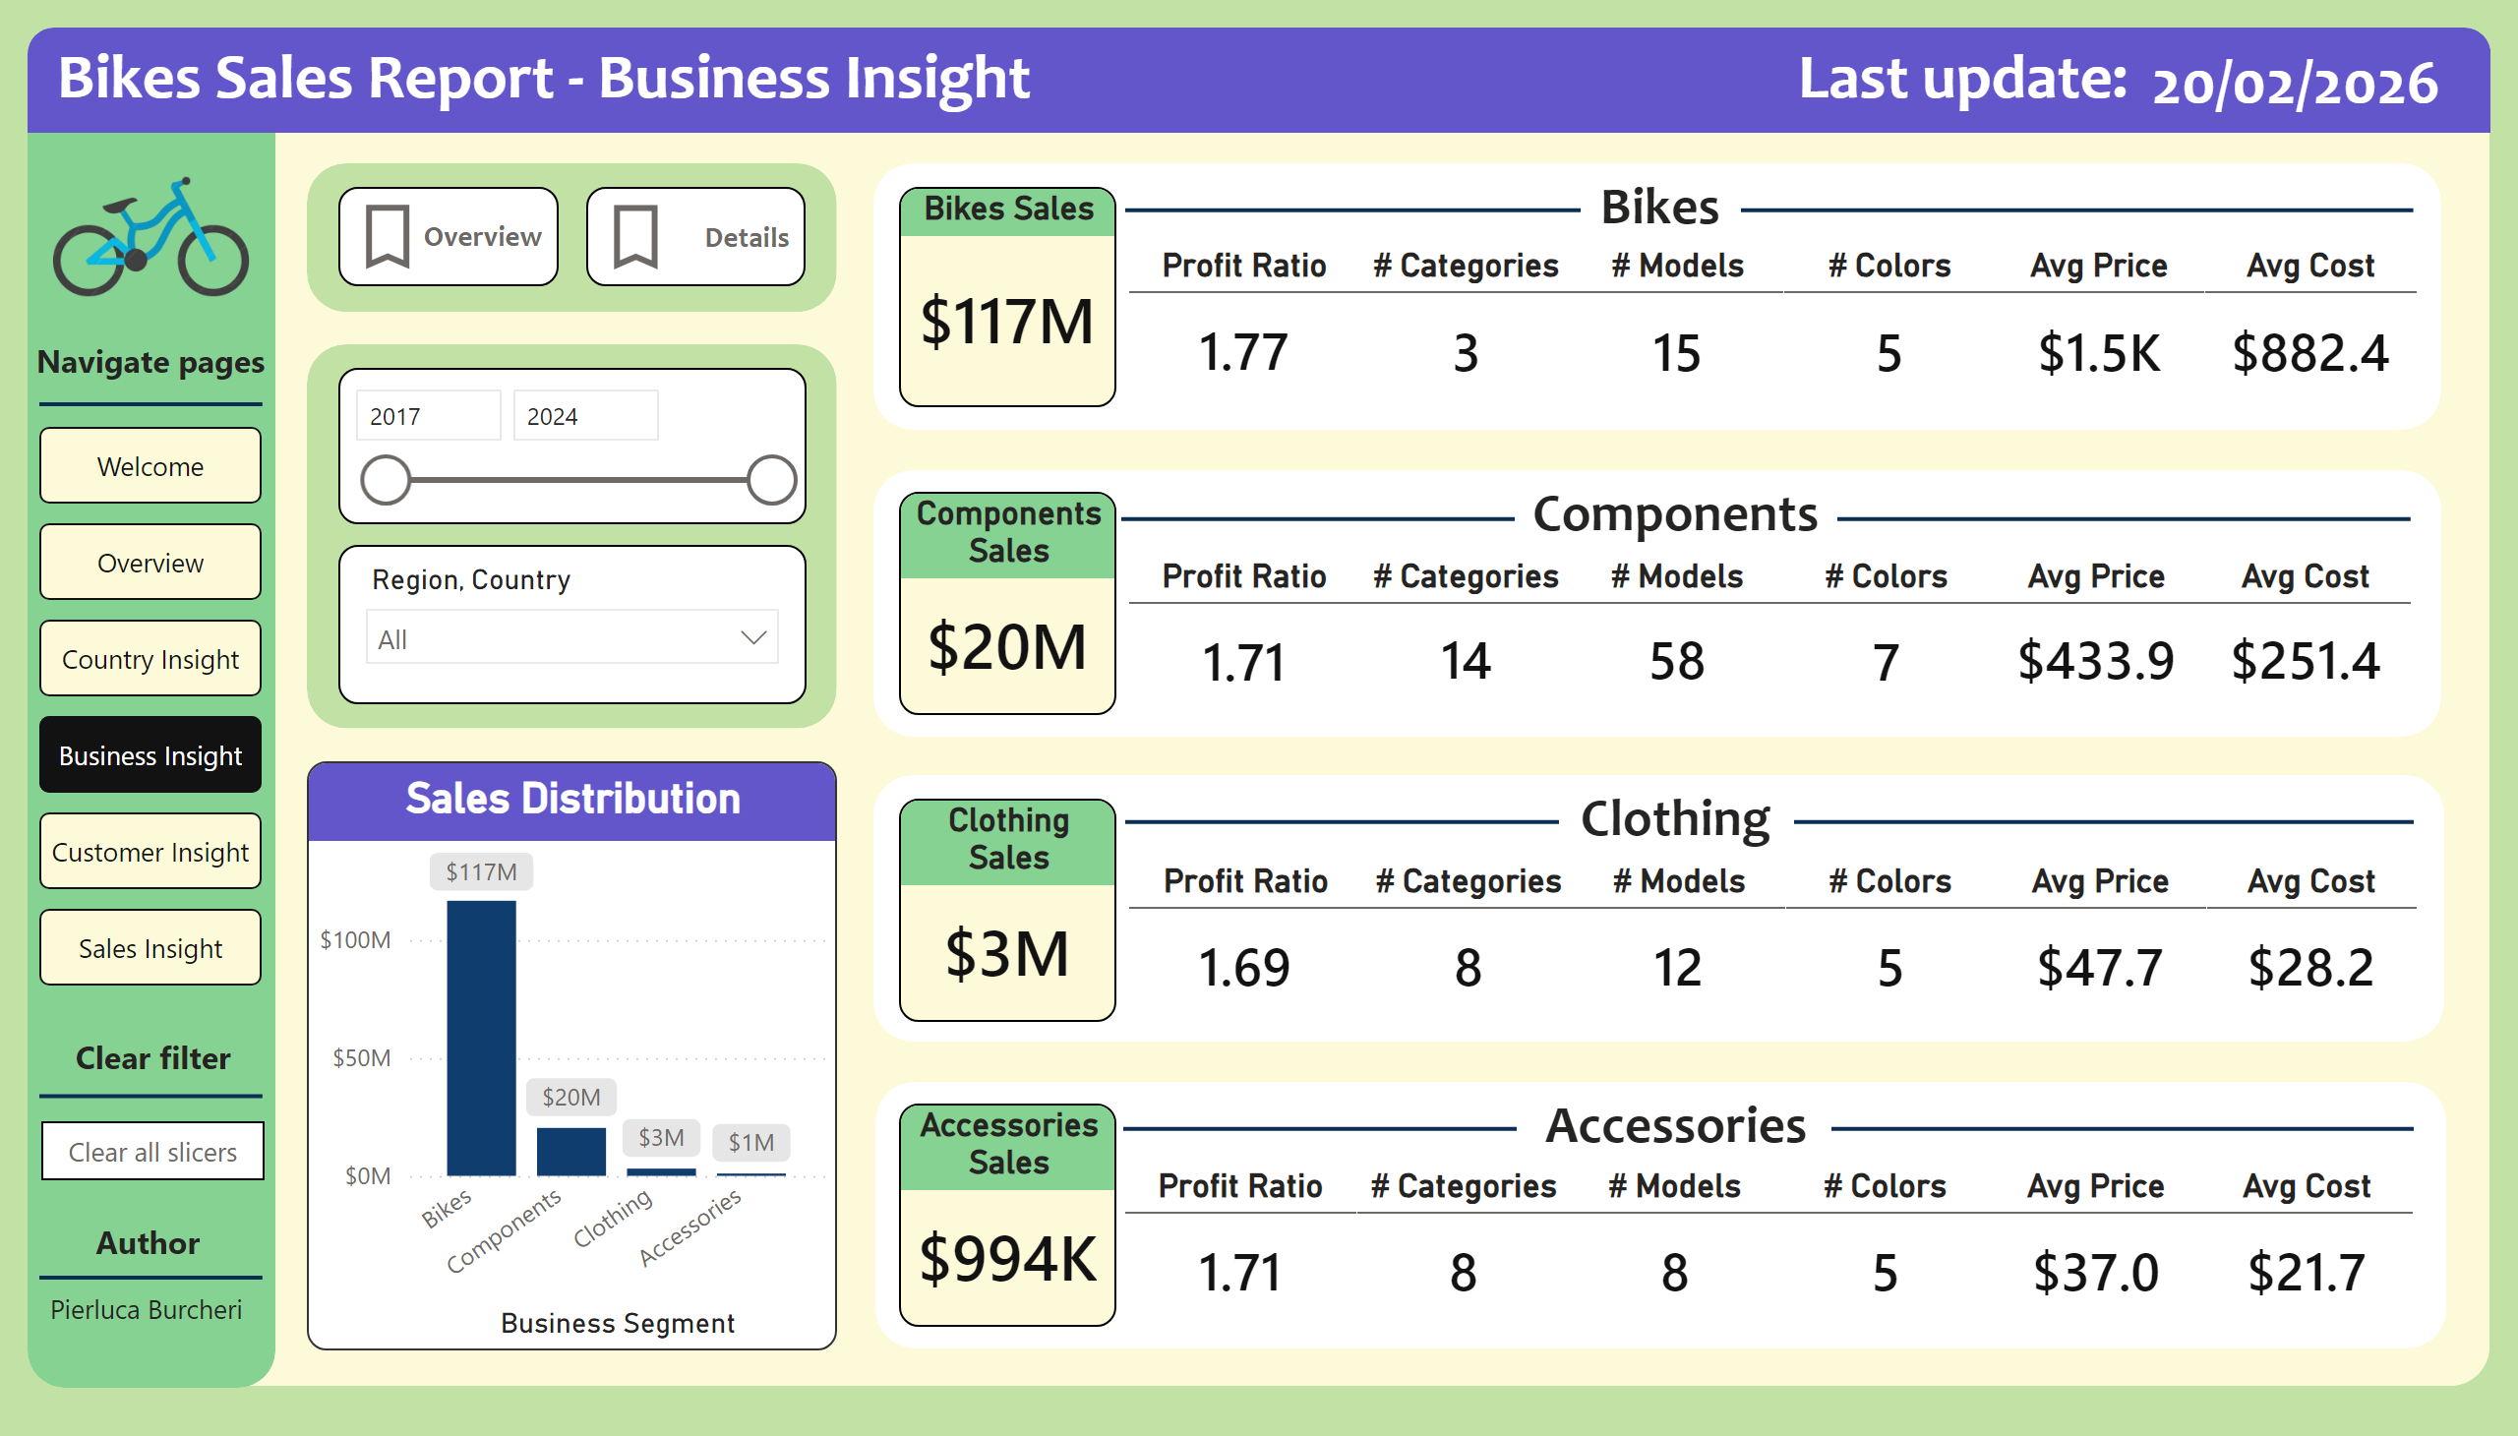
Business Insight
Notes:
textbox
No alt text provided
shape
No alt text provided
shape
No alt text provided
textbox
No alt text provided
card
No alt text provided
shape
No alt text provided
shape
No alt text provided
image
No alt text provided
textbox
No alt text provided
shape
No alt text provided
pageNavigator
No alt text provided
shape
No alt text provided
textbox
No alt text provided
shape
No alt text provided
Profit Ratio
No alt text provided
# Categories
No alt text provided
# Models
No alt text provided
# Colors
No alt text provided
Avg Price
No alt text provided
Avg Cost
No alt text provided
shape
No alt text provided
Bikes Sales
No alt text provided
shape
No alt text provided
textbox
No alt text provided
shape
No alt text provided
Profit Ratio
No alt text provided
# Categories
No alt text provided
# Models
No alt text provided
# Colors
No alt text provided
Avg Price
No alt text provided
Avg Cost
No alt text provided
shape
No alt text provided
Components Sales
No alt text provided
shape
No alt text provided
textbox
No alt text provided
shape
No alt text provided
shape
No alt text provided
Accessories Sales
No alt text provided
shape
No alt text provided
textbox
No alt text provided
shape
No alt text provided
Profit Ratio
No alt text provided
# Categories
No alt text provided
# Models
No alt text provided
# Colors
No alt text provided
Avg Price
No alt text provided
Avg Cost
No alt text provided
shape
No alt text provided
Clothing Sales
No alt text provided
slicer
No alt text provided
slicer
No alt text provided
Sales Distribution
No alt text provided
shape
No alt text provided
pivotTable
No alt text provided
actionButton
No alt text provided
actionButton
No alt text provided
actionButton
No alt text provided
textbox
No alt text provided
shape
No alt text provided
shape
No alt text provided
textbox
No alt text provided
textbox
No alt text provided
Profit Ratio
No alt text provided
# Categories
No alt text provided
# Models
No alt text provided
# Colors
No alt text provided
Avg Price
No alt text provided
Avg Cost
No alt text provided

Slide 6
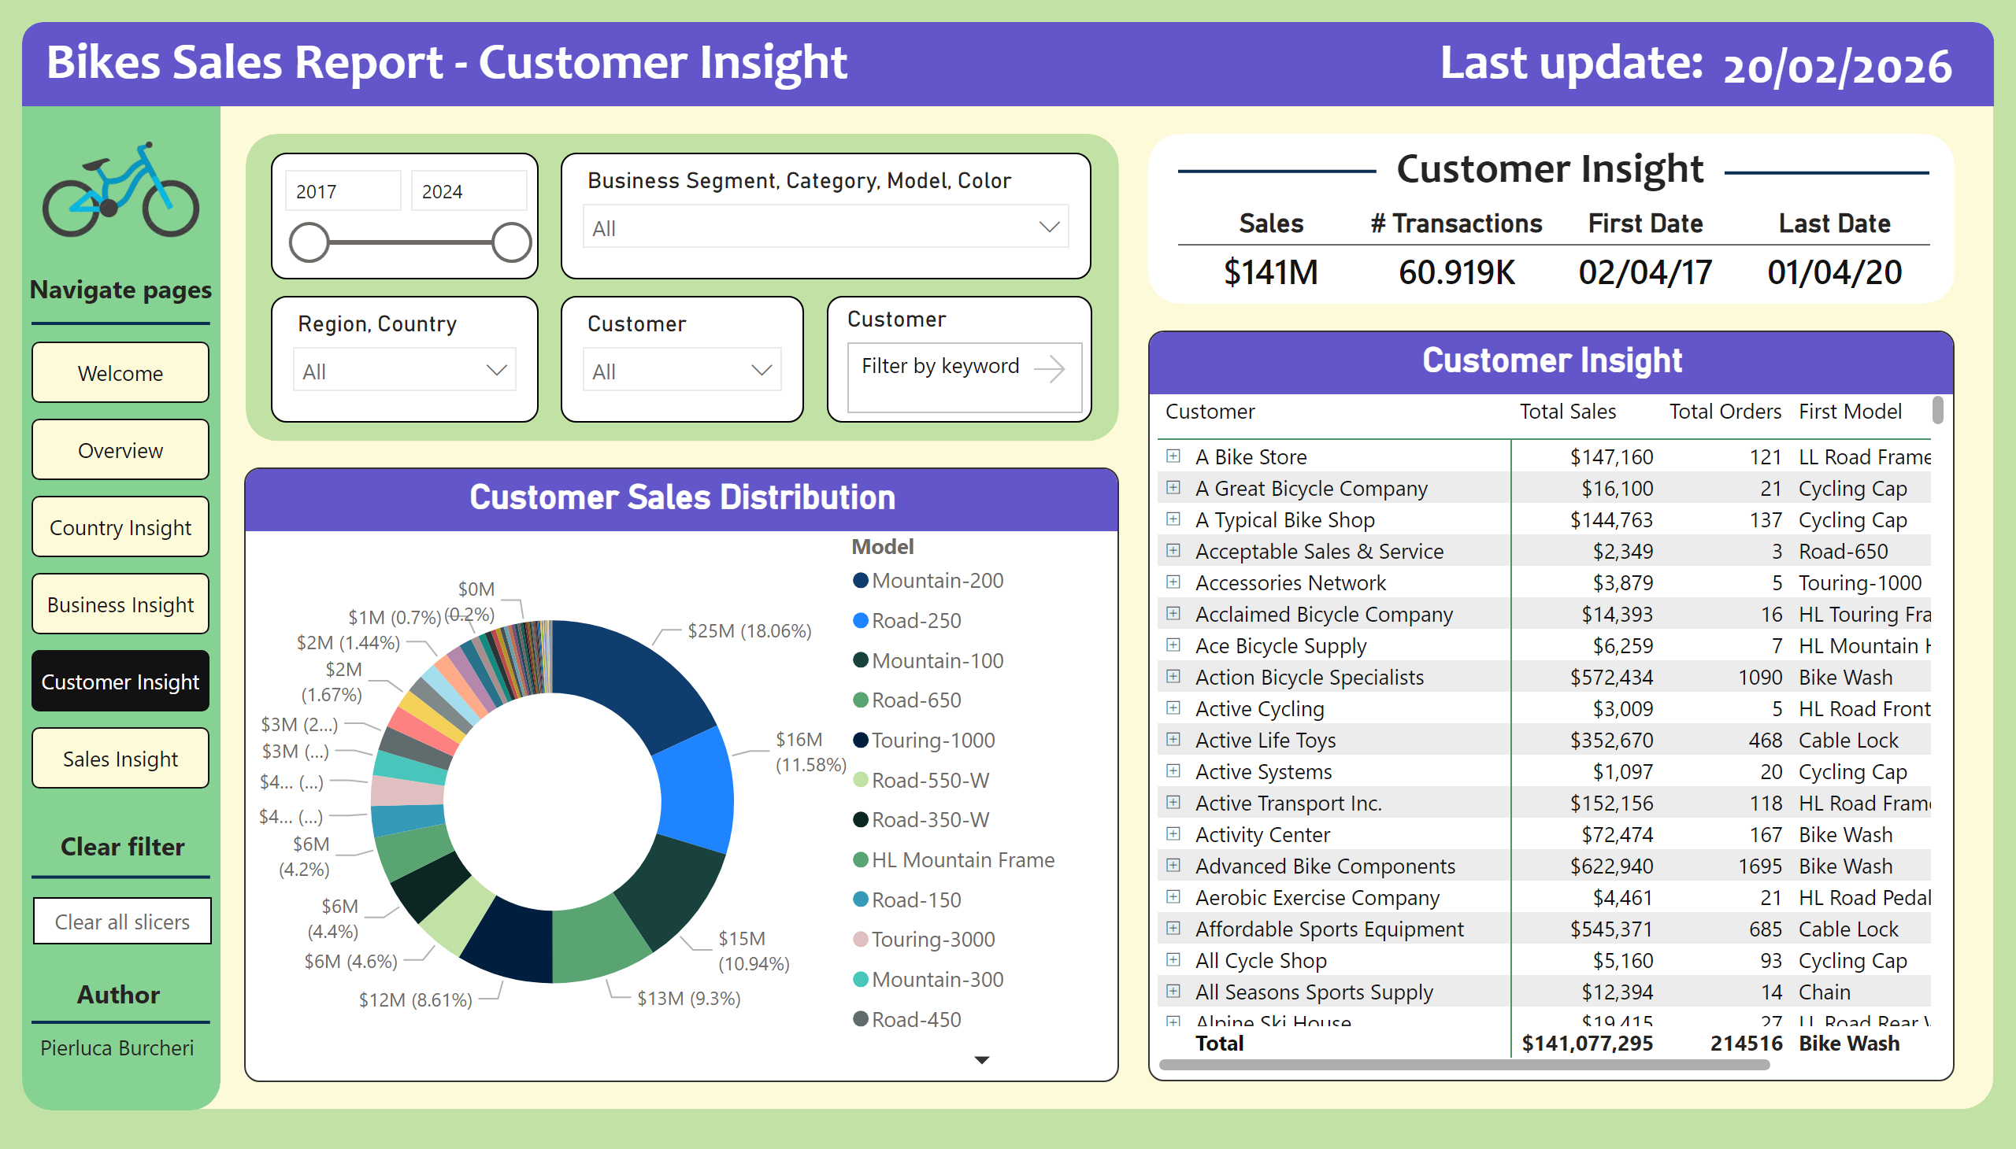
Customer Insight
Notes:
textbox
No alt text provided
shape
No alt text provided
shape
No alt text provided
textbox
No alt text provided
card
No alt text provided
Customer Insight
No alt text provided
shape
No alt text provided
image
No alt text provided
textbox
No alt text provided
shape
No alt text provided
slicer
No alt text provided
pageNavigator
No alt text provided
actionButton
No alt text provided
textbox
No alt text provided
shape
No alt text provided
shape
No alt text provided
textbox
No alt text provided
textbox
No alt text provided
slicer
No alt text provided
slicer
No alt text provided
slicer
No alt text provided
shape
No alt text provided
textSlicer
No alt text provided
Customer Sales Distribution
No alt text provided
shape
No alt text provided
shape
No alt text provided
textbox
No alt text provided
Sales
No alt text provided
# Transactions
No alt text provided
shape
No alt text provided
First Date
No alt text provided
Last Date
No alt text provided

Slide 7
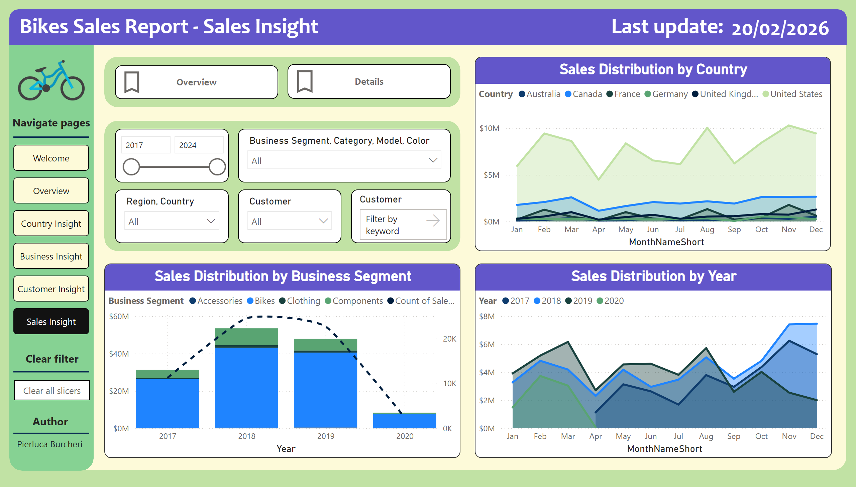
Sales Insight
Notes:
textbox
No alt text provided
shape
No alt text provided
shape
No alt text provided
textbox
No alt text provided
card
No alt text provided
shape
No alt text provided
image
No alt text provided
textbox
No alt text provided
shape
No alt text provided
Sales Distribution by Business Segment
No alt text provided
Sales Distribution by Year
No alt text provided
Sales Distribution by Country
No alt text provided
pageNavigator
No alt text provided
actionButton
No alt text provided
textbox
No alt text provided
shape
No alt text provided
shape
No alt text provided
textbox
No alt text provided
textbox
No alt text provided
pivotTable
No alt text provided
pivotTable
No alt text provided
pivotTable
No alt text provided
slicer
No alt text provided
slicer
No alt text provided
slicer
No alt text provided
slicer
No alt text provided
shape
No alt text provided
textSlicer
No alt text provided
shape
No alt text provided
actionButton
No alt text provided
actionButton
No alt text provided

